Slide 1

Epileptic Seizure Detection using Deep Convolutional Autoencoder
LEEYEONSU
2019.07.31

Slide 2

Index
EEG Spectral Feature Based Seizure Prediction using an Efficient Sparse Classifier
Ahmed M. Abdelhameed
2018 IEEE

Slide 3
Index
Introduction
Proposed method
Dataset
1D Convolutional Autoencoder
Neural network based classifiers
Multilayer Perceptron
LSTM
Bidirectional LSTM
Training and Experimental Results
Data selection
Convolutional autoencoder training
Classifiers training
Results

Slide 4
PROPOSED ALGORITHM
Dataset
CHB-MIT
17 children
78 seizures
647hours of recording
Sampling rate : 256Hz/sec
Window Based Signal Processing
Segment : 4sec
Overlap : 50%
Seizure prediction : every 2sec

Slide 5
PROPOSED ALGORITHM
Feature extraction
Feature : 8 sub-bands
Theta (4-8Hz)
Alpha (8-13Hz)
Beta (13-30Hz)
Gamma1 (30-50Hz)
Gamma2 (50-70Hz)
Gamma3 (70-90Hz)
Gamma4 (90-110Hz)
Gamma5 (110-128Hz)

Slide 6
PROPOSED ALGORITHM
Feature extraction
Absolute Spectral Power
Power of the signal in that particular frequency band
Relative Spectral Power
Ratio of power of the signal in that frequency band to the total power of the signal considering all the frequency bands
RSP = BSP / TSP
BSP(Band Spectral Power), TSP(Total Spectral Power)
Spectral Power Ratio
Between two bands is the ratio of spectral powers in those frequency bands
Major problem
Spectral power fluctuates not only in the preictal period but also in the inter-ictal period (decreases reliability to predict)
Overcoming problem
By considering spectral power ratios
More indicative of an upcoming ictal events

Slide 7
PROPOSED ALGORITHM
Feature Selection
To reduce this feature set to optimum level ,
Need to select features that contribute the most to seizure prediction
Method
Sparse feature selection
Sparse Bayesian Multinomial Logistic Regression(SBMLR) technique (NIPS 2007)
a-posteriori estimate of the probability that a pattern belongs to each of Disjoint classes
Regularization parameter is used to check if it is below a threshold or not.
Regularization parameter = The value of the gradient of this function
Features selected for Classification
4
31
42
< SELECTED FEATURES AFTER FEATURE SELECTION STAGE >

Slide 8
PROPOSED ALGORITHM
Classification
Sparse classifier (machine learning)
Classification
inter-ictal
Pre-ictal
For linearly non-separable data
Used Sparse kernel function
Make the data can be linearly separable
Algorithm
SRC ( Sparse Representation Classifier)
KSRC ( Kernel Sparse Representation Classifier)
Notes:
Sparse kernel function
Implementation of Sparse Representation Classifier(SRC) to heartbeat biometrics
Kernel = 연립일차방정식

Slide 9

PROPOSED ALGORITHM
Classification
SRC (Sparse Representation Classifier)
Consider a data as a linearly separable
Consider a data as a linearly non-separable
Sparse kernel function is used to map the data in to higher dimension
The data can be considered linearly separable
$V_{test}$ = $αV$
$V_{test}$ = signal to predict
$α$ = coefficient matrix
$V$ = training set
${∥V}_{test}$ - $αV∥$ = $E$
$E$ = error value
Minimum error $E$
Notes:
Sparse kernel function
Implementation of Sparse Representation Classifier(SRC) to heartbeat biometrics

Slide 10
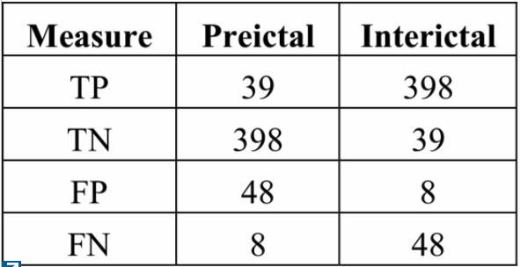
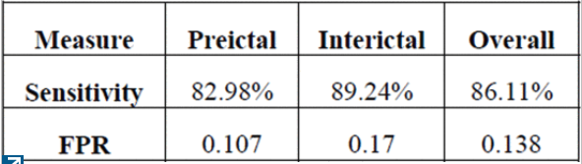
Results
Evaluated on Matlab2013 software
Preictal period
Between a preictal state has been identified & actually ictal happens
Performance measurement
Sensitivity = TP / ( TP + FN ) * 100
False Positive Rate ( FPR ) = FP / ( FP + TN )
?
< TABLE OF CONFUSION OF PROPOSED METHOD >
< PERFORMANCE PARAMETERS OF PROPOSED METHOD >
?
measure | sensitivity | specificity | FPR
 | 82.98% | 89.24% | 0.107

Slide 11
Backup Slides

Slide 12
LITERATURE SURVEY
Related work
Adaboost
Adaptive Neuro Fuzzy Inference System
Spike rate as the feature
Spatial and temporal covariance matrix between different EEG channels
Spectral power of various EEG bands (SVM for classification)
HPD(Henze Penrose Divergence) - the factor to decide the reliability of a feature
Cross correlation coefficients between different EEG electrodes
Phase correlation between different EEG channels
Proposed method
Efficient sparse classifier for preictal event identification

Slide 13
PROPOSED ALGORITHM
Sparse feature selection
SBMLR

Slide 14
Kernel function
원점을 중심으로 대칭이며 적분값이 1 인 양의 함수로 정의할 수 있습니다.

